Slide 1
Demystifying Blockchain
And What It Means For Marketers

Slide 2
What is Blockchain?
A database that no one person or organization controls
Ledger of records of anything that can be recorded, such as transactions, ownership of assets, contracts, sources of goods, supply chain details, individual health information, and authenticity of items or credentials
All records are distributed to what some say is thousands of computers, and each has its own copy
The detail on each record is called a “block”
“Hashing” is used to transform records to what looks like random characters
A transaction must be accepted by all other computers after they validate none of the assets were already used (such as an event ticket)
After approval, a block is time-stamped and encrypted, then added to the “chain” of previous blocks
Any attempted change to a hash is visible immediately for that block and every block after it, so blockchain greatly reduces fraud

Slide 3
How Blockchain Works

Slide 4
Legitimacy Statistics
Blockchain will deliver $176 billion in value to businesses by 2025 and $3.1 trillion by 2030. Gartner
The global market size for blockchain technology is expected to achieve a 42.8% annual compound growth rate until 2022. Netscribes, Inc.
The number of blockchain developers and consultants will increase by 10x by 2021. IDC
1 of 3 C-level executives use or are considering adopting blockchain technology for their organization. IBM Study
Global spending on blockchain is forecasted to grow from $1.8 billion in 2018 to $8.1 billion in 2021. IDC

Slide 5
Industry Uses of Blockchain
Banking
Faster, more economical fund transfers, secure records
Healthcare
Safe transfer of patient medical records, secure storage of patient data
Entertainment
Use of data to create media plans for target audiences, reconciling reporting to advertisers

Slide 6
Industry Uses of Blockchain
Manufacturing
Supply chain management and tracking
Retail
Verification of name brand items being sold
Auto Dealerships
Maintenance records, especially for purchases of previously owned vehicles

Slide 7
Industry Uses of Blockchain – continued
Pharmaceuticals
Supply chain for prescription drugs
Government
Voting, ID cards and public records
General Business
Verification of candidate credentials during the hiring process

Slide 8
Critical Reviews & Assessments
“The distributed ledger technology, better known as blockchain, has the potential to eliminate huge amounts of record-keeping, save money and disrupt IT in ways not seen since the Internet arrived.” Computerworld
“It will take decades for blockchain to seep into our economic and social infrastructure.” Harvard Business Review
“Blockchains are not merely database technology that reduces the cost of storing or sharing data, but have profound economic implications on consensus generation, industrial organization, smart contract design and antitrust policy.” Lin William Kong and Zhiguo He

Slide 9
Benefits
Operational cost savings
Can’t handle high transaction levels yet
A clear business need hasn’t yet been identified by most businesses
Increased efficiency
Transparency
Regulatory concerns
Confidentiality – widespread access
Barriers
Verification of authenticity
Prevents tampering with records
Hacking would be drastically reduced
Lack of standardization in software

Slide 10
Pros and Cons for Marketers
Pros
* Marketers can back up claims of value and authenticity of goods and services.
* Digital ad fraud can be reduced so marketers will pay only for verified clicks.
* Each consumer journey can be validated and analyzed, which provides valuable data for developing strategies.
* Mobile marketers will be able to pay consumers to view their ads and potentially skip the “middleman”
Cons
* Blockchain implies 100% accuracy, but it’s a big risk for a brand to make that promise to customers.
*Most consumers don’t understand it, so it could damage customer experience if used by marketers.
* Transactions can’t be reversed, so customers may be hesitant.
* Controversial -banks, lawyers and government no longer needed for transactions.

Slide 11
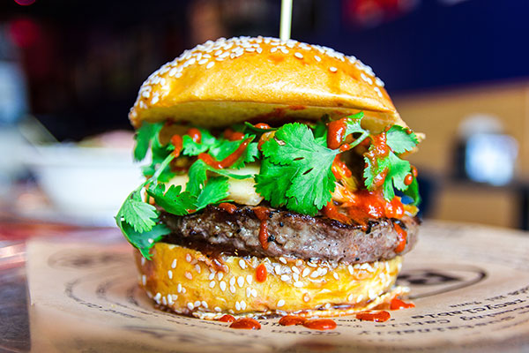
How Marketers Are Using Blockchain
BGR Burgers Grilled Right (Chanticleer Holdings)
Loyalty Program
Will reward customers with units of cryptocurrency via a blockchain platform (coming mid-2018)
To be used for future meals across their brands, or traded with friends
Stock rose 95% over previous value with news of using blockchain, then leveled at 48%

Slide 12
How Marketers Are Using Blockchain
Babyghost Fashion Label
Shanghai Fashion Week
Consumers could verify authenticity of designer handbags using Blockchain
Could scan tags with mobile phones to see “story” of where a clothing design was from, who modeled it
Improved the customer digital experience, enabled customers to build a personal connection with Babyghost products they own

Slide 13
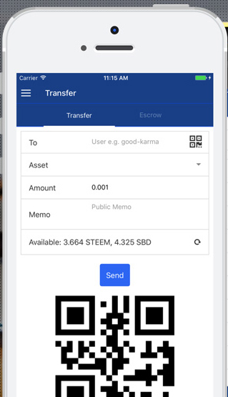
How Marketers Are Using Blockchain
Steem Social Network
Uses Blockchain to reward members for good content
Members vote on (like) content
Writers, curators, participants get digital currency that can be exchanged for regular currency
eSteem mobile interface enables social feature access, fund transfer
Community is thriving, content is exceptional

Slide 14
Legal and Ethical Implications
Legal Risks
Security and confidentiality pose significant legal risks.
Legal Issues
Blockchain is decentralized, so there could be challenges determining which country’s laws would govern.
Ethical Concerns
Data can never be erased with blockchain, which removes the right of individuals to have convictions of children sealed or fines removed after a set period of time.
Data privacy for industries like banking is required; this may lead to the creation of private blockchains or other remedies.
“Smart contracts” are used for blockchain, which means a contract is automatically executed when pre-programmed conditions are met. It’s unclear how issues would be resolved if disputes were to arise.
If the blockchain service were to stop working, there’s a question of who would be liable in the decentralized structure.
Those who draft smart contracts may be considered engaging in the unauthorized practice of law depending on an agreement’s content, so an attorney should be consulted.

Slide 15
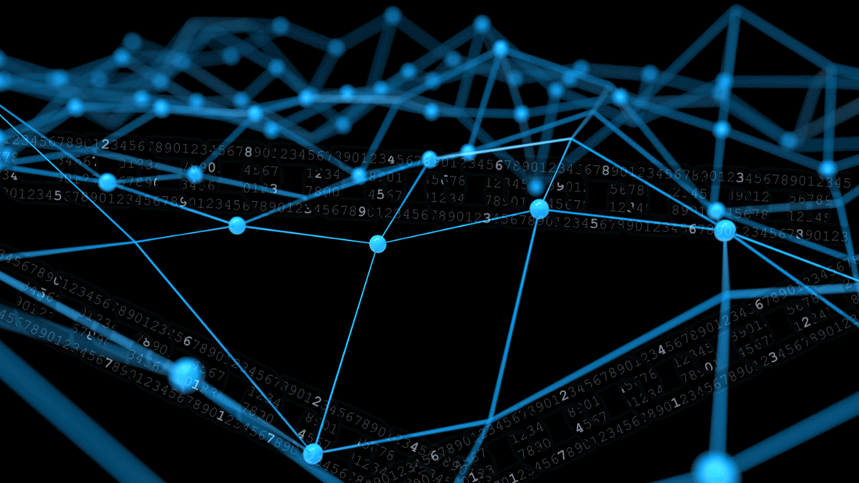
When Will it Become Mainstream?
Blockchain technology is in its infancy, so growth is anticipated to be slow and steady. Only a fraction of the world uses the technology now. There is momentum and myriad industries are exploring opportunities to harness the technology. Many analysts expect it to become mainstream in three to five years.

Slide 16
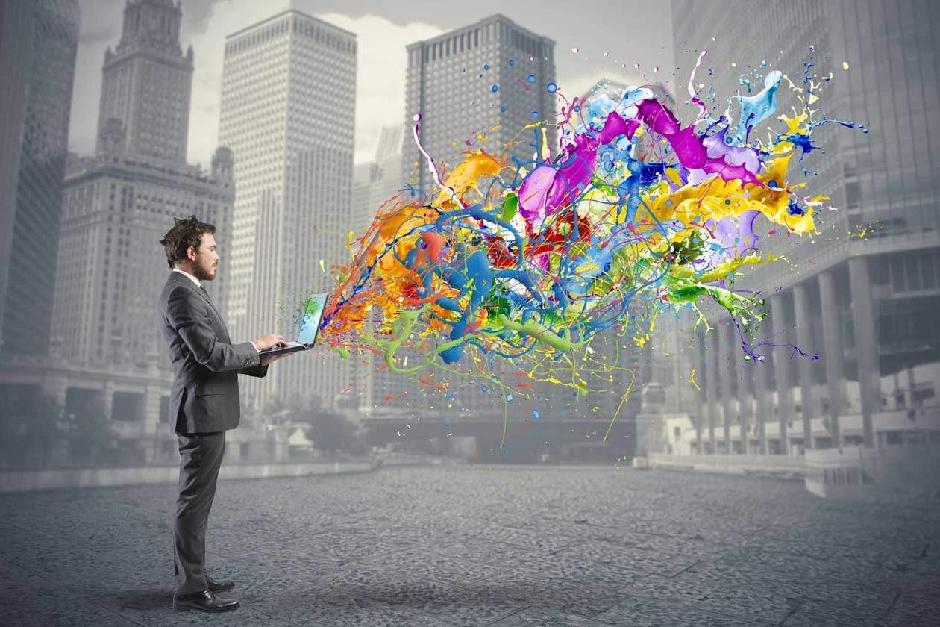
Mobile Marketing Recommendations
Encourage creative thinking and innovation within the company. Envision ways to incorporate the technology within two years and consider it in strategic planning.
Form a cross-functional team to monitor blockchain developments among peers and other industries.
Learn from mistakes made by other companies with blockchain.
Keep on track with budgeting – proven marketing strategies will deliver a better ROI than re-allocating resources to an unproven technology.

Slide 17
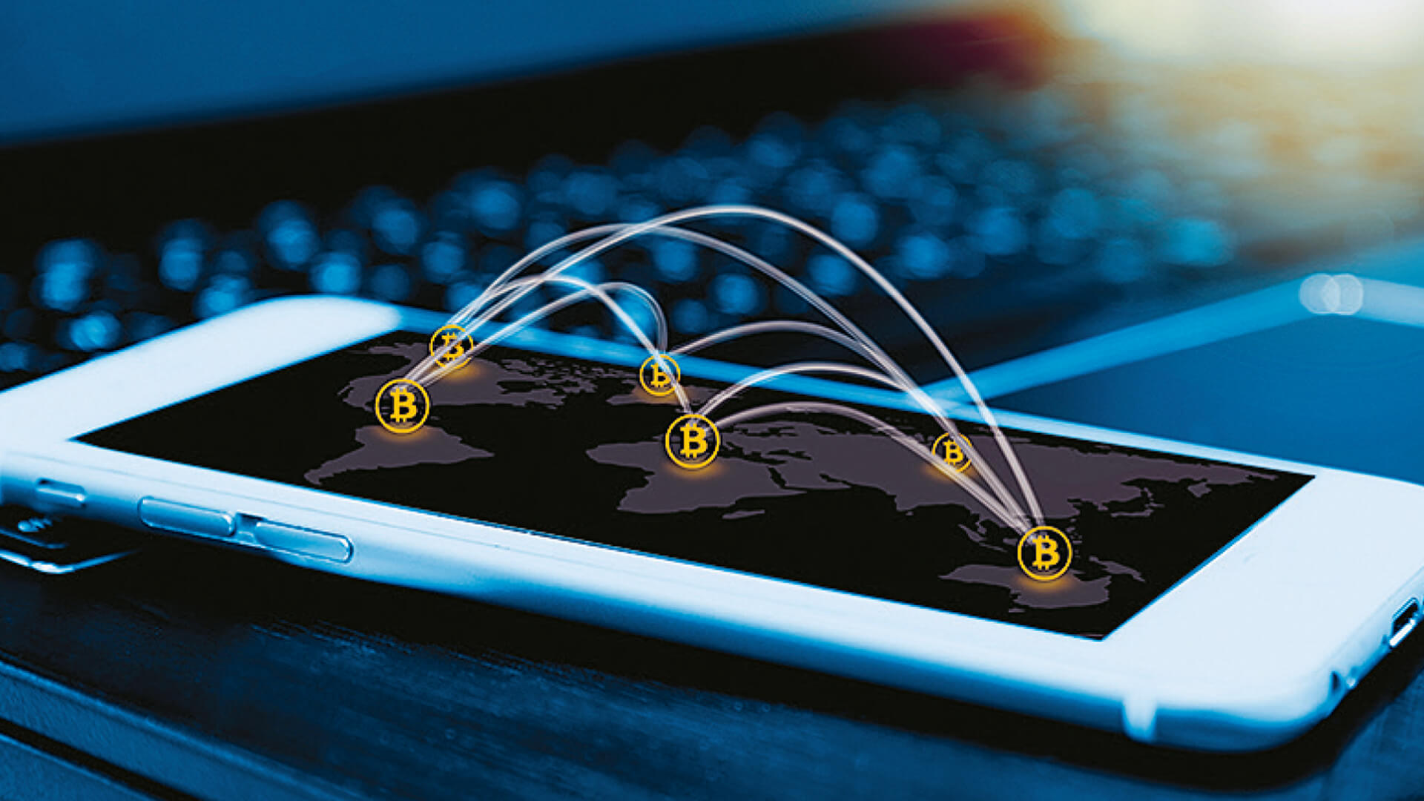
Mobile Marketing Recommendations continued
Consider future marketing opportunities:
Customer intelligence – pay via blockchain for individual customer psychographic and behavioral information
Social media – verify number of actual followers (versus bots) of influencers before including influencers in marketing strategies and campaigns
Use blockchain to verify digital ad impressions and clicks to boost ROI

Slide 18
Consumer Benefits
Speed of Transactions No financial institution is needed because payments can be made person to person
Engagement Customers can earn brand loyalty rewards, get paid for content
Security & Value Records can’t be changed, can see proof of seller claims, online identity protected or faked

Slide 19
Works Cited
Marr, Bernard. (2017, September 21). 14 Things Everyone Should Know About Blockchains. Retrieved April 29, 2018 from https://www.forbes.com/sites/bernardmarr/2017/09/21/14-things-everyone-should-know-about-blockchains/#3c65dbd8252a Institute for the Future. (2016, April 18). Understand the Blockchain in Two Minutes. Retrieved April 22, 2018 from https://www.youtube.com/watch?v=r43LhSUUGTQ Lovelock, John-David. Reynolds, Martin. Granetto, Bianca Francesca. Kandaswamy, Rajesh. (2017, March 02). Forecast: Blockchain Business Value, Worldwide, 2017-2020. Retrieved April 22, 2018 from https://www.gartner.com/doc/3627117/forecast-blockchain-business-value-worldwide (2018, January 18). The Blockchain Market is Expected to Grow. Retrieved May 05, 2018 from https://www.prnewswire.com/news-releases/the-blockchain-technology-market-is-projected-to-grow-669923133.html Loeb, Larry. (2017, May 23). IBM Study: Blockchain Adoption on the Rise. Retrieved May 04, 2018 from https://securityintelligence.com/news/ibm-study-blockchain-adoption-on-the-rise/ (2018, February 12). Worldwide spending on blockchain services to reach $8.1 billion in 2021. Retrieved May 05, 2018 from https://www.helpnetsecurity.com/2018/02/12/worldwide-spending-on-blockchain-services/

Slide 20
Works Cited - continued
Mearian, Lucas. (2018, January 18). What is blockchain? The most disruptive tech in decades. Retrieved May 02, 2018 from https://www.computerworld.com/article/3191077/security/what-is-blockchain-the-most-disruptive-tech-in-decades.html Iansiti, Marco and Lakhani, Karim R. (2017, January-February). The Truth About Blockchain. Retrieved May 02, 2018 from https://hbr.org/2017/01/the-truth-about-blockchain Jacobs, Rose. (2018, February 12). The good and bad of blockchain. Retrieved May 04, 2018 from http://review.chicagobooth.edu/finance/2018/article/good-and-bad-blockchain Forbes Agency Council. (2018, February 27). 10 Ways Blockchain Could Change the Marketing Industry This Year. Retrieved May 02, 2018 from https://www.forbes.com/sites/forbesagencycouncil/2018/02/27/10-ways-blockchain-could-change-the-marketing-industry-this-year/#3f8c7ed648ba Pathak, Shareen. (2016, December 15). How blockchain might be useful in marketing and advertising. Retrieved May 02, 2018 from https://digiday.com/marketing/blockchain-tech-might-useful-marketing/ (2018, January 02). Chanticleer Holdings to Deploy Mobivity’s Blockchain Technology to Power Cryptocurrency Rewards Program. Retrieved April 24, 2018 from https://globenewswire.com/news-release/2018/01/02/1277006/0/en/Chanticleer-Holdings-to-Deploy-Mobivity-s-Blockchain-Technology-to-Power-Cryptocurrency-Rewards-Program.html

